Slide 1
Company Presentation

Slide 2
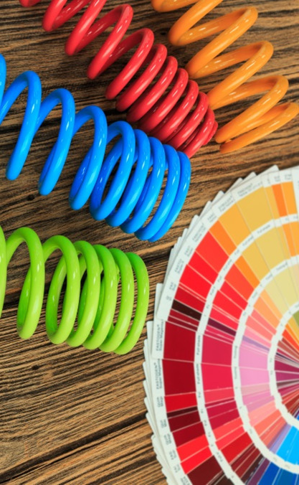
CONTENTS
TITLE | SLIDE NUMBER
About Us | 3
Certificates | 4-5
Infrastructure | 6
R&D | 7
Why Powder Coating? | 8
Sustainability | 9
Products | 10-15
Factors behind our success | 16
Our Customers | 17
Contact Us | 18

Slide 3
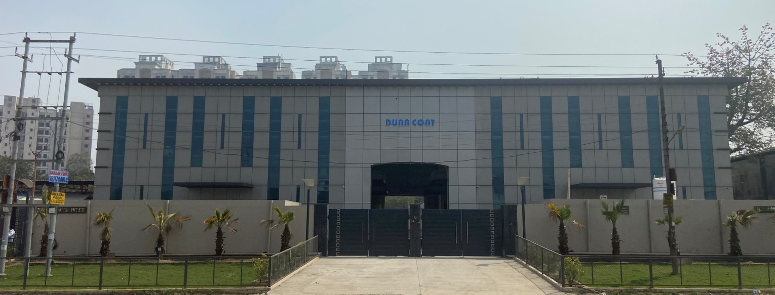
ABOUT US
Sirohi Chemtech Pvt. Ltd. started its operations in the year 1997.
25 years into Manufacturing and supplying of Metal Surface Finishing Chemicals and Dura Coat Powder Coatings across the country.
ISO 9001:2008 certified.
Brand Name “DURA COAT”.
Located at Surajpur Industrial area in Greater Noida.

Slide 4
CERTIFICATES
ISO 9001:2008

Slide 5
CERTIFICATES
CRISIL

Slide 6
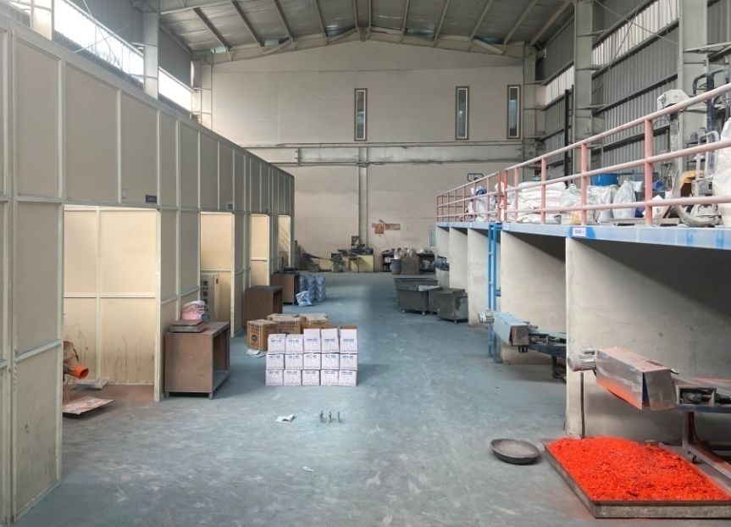
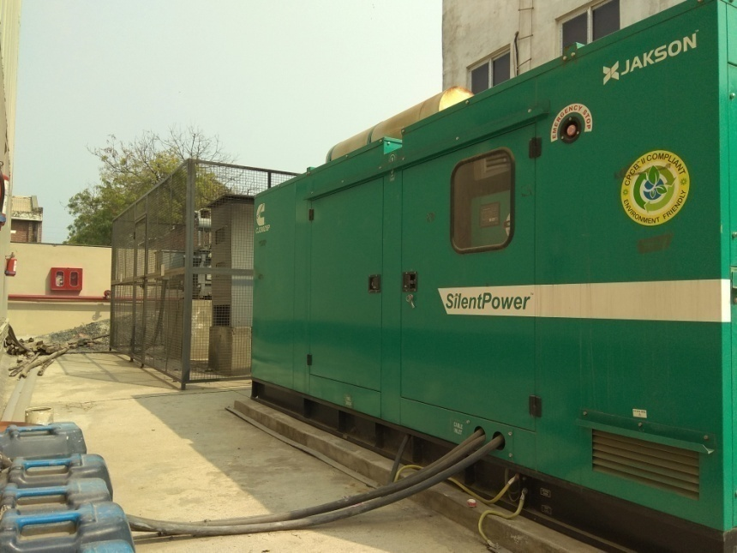
INFRASTRUCTURE
40,000 square feet of production facility.
24 Hours of operation and Power Backup.
6 twin-screw co-rotating extruders with cooling belts.
72,000 tonnes of annual capacity.
1500+ shades development.
70% market coverage in Architectural Grade Powder in Delhi-NCR.

Slide 7
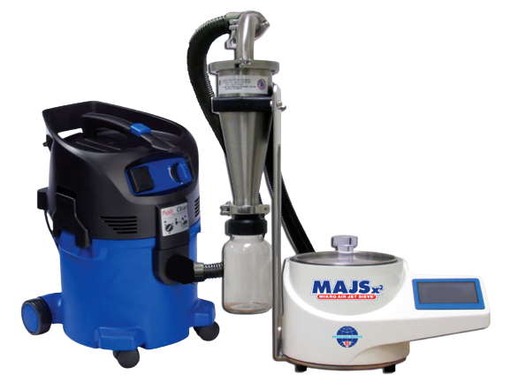
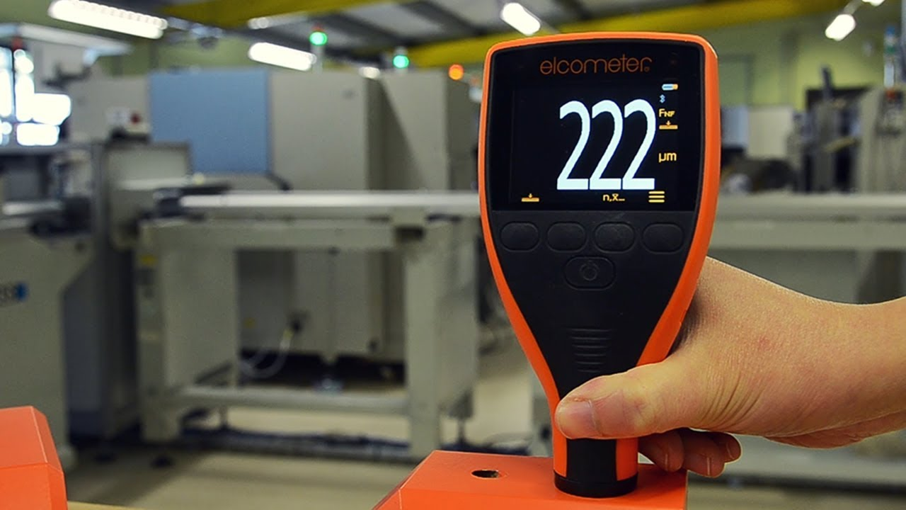
R&D LABRATORY
Atlas Xenon-Arc Weatherometer.
(DFT) Measurement Equipment.
Hunter Lab Colour Matching Instrument.
Scratch & Chemical Resistance Equipment.
Gloss Measurement Instrument.
Air Jet Sieve Particle Size Analyser.
Salt Spray Equipment

Slide 8
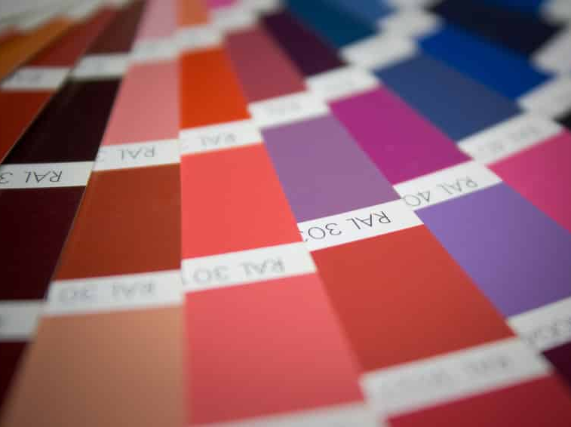
WHY POWDER COATING?
Safe, Clean and Economical.
Solvent-Free.
No Volatile Organic Compounds (VOC).
Free of any toxic metals such as Lead and Chromium.
No hazardous material used during cleanup.
Reduced risk of fire.
Achieves a high film thickness easily, up to 150 micron in one coat.
Highly Durable.
Improved productivity.

Slide 9
SUSTAINABILITY
Low Carbon Footprint.
Helps in reducing Air Pollution.
Reduces Health Hazards to operators.
Reduces processing time.
Reduces energy required as compared to aqueous based paints.
Flexible in use as can be used in certain no- metallic surfaces.

Slide 10
PRODUCTS
THERMOSETTING POWDER
PURE EPOXY
EPOXY POLYESTER (HYBRID)
FINISHES
GLOSSY
SEMI GLOSSY
MATT FINISH
RAL FINISH
TEXTURE
HAMMERTON
ANTIQUE FINISH
PURE POLYSTER
SATIN FINISH
PRE-TREATMENT CHEMICALS

Slide 11
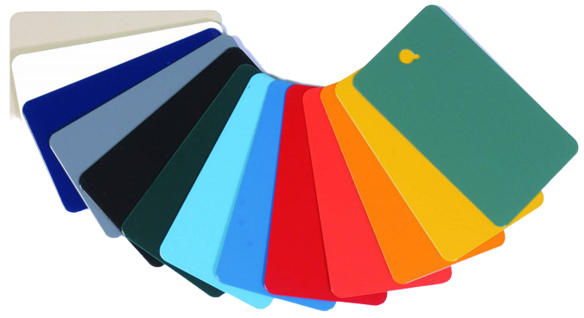
PRODUCTS
PURE EPOXY
They are recommended for interior use.
These have excellent corrosion resistance.
They are available in matt finish.
Applications
Auto components, Panels, hand tools, brassware, Al- extrusions, electrical components, hospital equipments, ceiling panels, bathroom fittings, coatings for pipes and many others.
Curing Requirement
200˚C object temperature for 10-12 minutes.

Slide 12
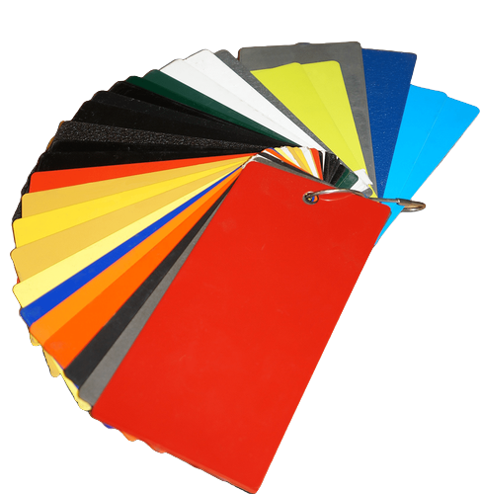
PRODUCTS
PURE POLYESTER
It is recommended for both interior and exterior use.
They are available in glossy, semi glossy and our specially developed product is available in matt finish.
These products have excellent gloss retention, good levelling, over bake resistance, mar resistance and have excellent mechanical properties.
Applications
Agricultural equipments, outdoor furniture,
architectural facades & windows and many others.
Curing Requirement
200˚C object temperature for 10-12 minutes.

Slide 13
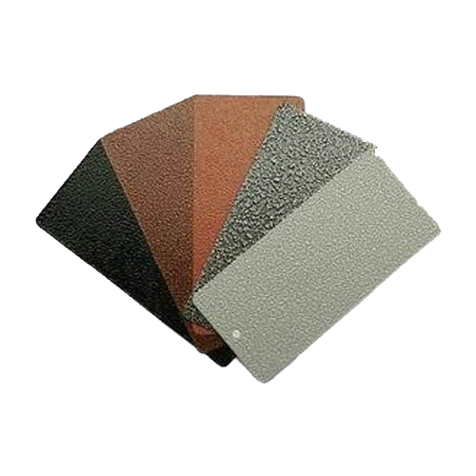
PRODUCTS
EPOXY POLYESTER (HYBRID)
It is a mixture of Epoxy and Polyester Resins.
They are easy to apply.
These have excellent decorative appearance.
They are available in glossy, matt, structure, texture and antique finish.
Applications
Mainly used for consumer durables, office equipments and furniture, light fixtures, Sports goods, indoor components and appliances and many other.
Curing Requirement
180˚C object temperature for 10-12 minutes.

Slide 14
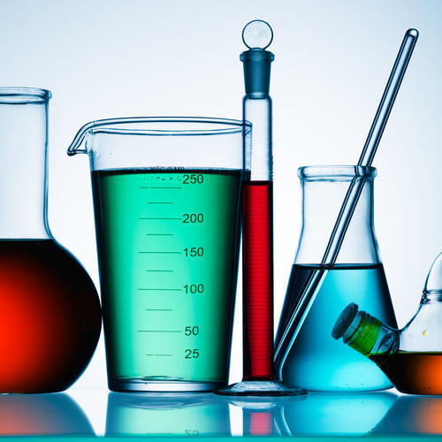
PRODUCTS
PRE-TREATMENT CHEMICALS
A good pre-treatment lays the foundation for a good finish.
To ensure an excellent metal painted surface, quality Pre-Treatment is essential.
SCPL is continuously into developing surface treatment solution that are innovative and cost effective.
Giving our customers a competitive advantage to meet their economic targets in challenging market.

Slide 15
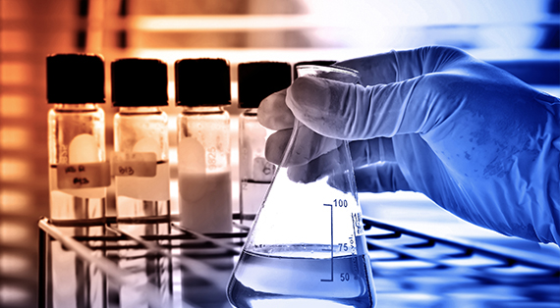
PRODUCTS
PRE-TREATMENT CHEMICALS
Pre-treatment is essential to reinforce the adhesion of the paint and hence improve corrosion resistance.
The required pre-treatment for different substrate are:
Mild steel : Zinc/ Iron phosphate
Aluminium : Chromate Conversion Treatment
Stainless Steel: Strong Acid Etching Treatment

Slide 16
FACTORS BEHIND OUR SUCCESS
SCPL extensive product line has reputation for providing quality that ranks with the best in the industry.
Ability to deliver on time without fail.
Diligent workforce.
Competitive price.
Ethical business policies.
Customized packaging.
Capacity to produce 7200 tonne annually with most stringent quality standards.
A wide market presence through direct and distributers.
Customer service oriented marketing personnel.

Slide 17
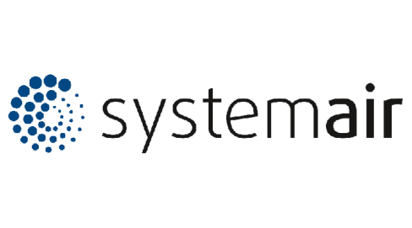
OUR CUSTOMERS

Slide 18
CONTACT US
Address : G-14 and 15, SITE-C, SURAJPUR INDUUSTRIAL AREA, Gautam Buddha Nagar, Greater Noida, Uttar Pradesh-201306, India.
Regd. Off : 110, MIG Flat, Suraj Apartment, New Delhi-44.
Phone : 0120-2978976, 9717188610, 9810135928, 9821257027.
E-Mail : sirohichemtech@gmail.com

Slide 19
LOOKING FORWARD TO SERVE YOU
THANK YOU

